Slide 1

Deep Learning & RL Strategy Design
April 28, 2025
Notes:
Good Eveneing, Professor. My name is Abhay Prabhakar. Today, I'll be presenting my final project, which explores image-based deep learning techniques and the design of a reinforcement learning strategy

Slide 2

Image-Based Deep Learning & RL Strategy Design
Introduction
Project covers two main areas: image-based deep learning tasks and reinforcement learning strategy design. Part A focuses on an image understanding pipeline including GAN-based image generation, object detection, and image captioning. Part B presents a conceptual design of a reinforcement learning approach tailored for the classic Pong game. Emphasis on practical implementation challenges, fallback solutions, and clear RL framework design. Intended for an academic audience to demonstrate understanding and methodological rigor.
Abhay Prabhakar
Notes:
This project integrates two key areas of AI. Part A involved building an image understanding pipeline, originally encompassing GAN-based image generation, followed by object detection and captioning. Part B required designing a conceptual strategy for an RL agent to play the classic game Pong. A significant aspect of this project was addressing practical implementation challenges; specifically, the initial GAN approach for image generation faced difficulties, leading us to adopt a fallback solution for subsequent steps, which proved effective. The overall goal is to demonstrate understanding of these methodologies.

Slide 3
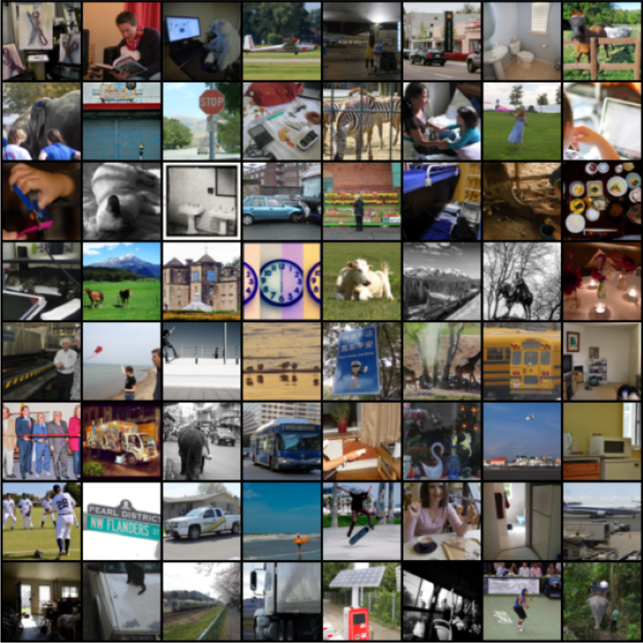
Part A Introduction & Dataset
Image Pipeline
Objective of Part A
Develop an image understanding pipeline involving image generation, detection, and captioning Explore generative adversarial networks (GANs) for image synthesis on a subset of COCO dataset Use object detection and image captioning models to analyze images
Dataset and Initial Plan
MS COCO train2017 dataset downloaded for GAN training (118,287 images) Intended to train a DCGAN on COCO subset for image generation Fallback adopted due to GAN output quality issues, using instructor-approved 5 fallback images for detection and captioning
Notes:
Part A aimed to develop a pipeline for image understanding. The objectives were to explore GANs for generating images, and then use object detection and captioning models to analyze those images. The primary dataset specified for training the GAN was the MS COCO 2017 training set, a large dataset with over 118,000 images, which was successfully downloaded. The initial plan involved training a DCGAN on a subset of this data. However, as we'll see next, due to challenges with the GAN output quality, we adopted an instructor-approved fallback, using 5 selected real images for the final detection and captioning stages.

Slide 4
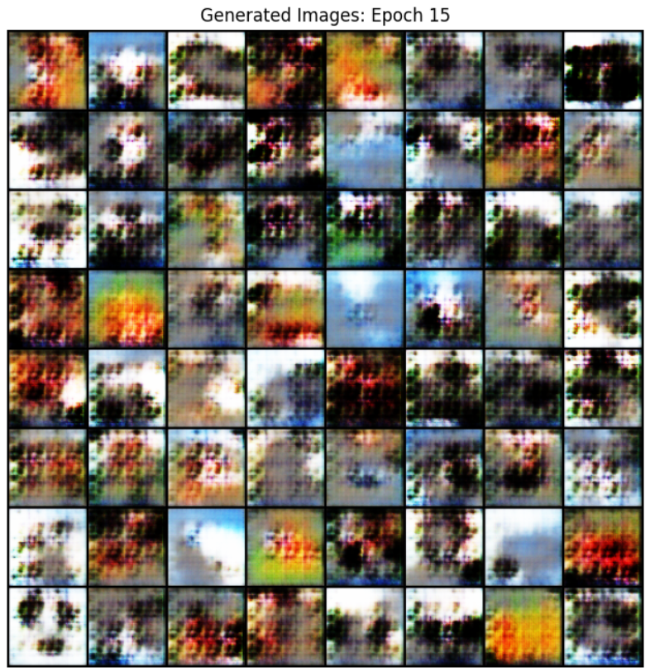
Step 1 Attempt: Image Generation using GAN
Part A
GAN Concept & Setup
Training Outcome & Challenges
Used DCGAN architecture with Generator and Discriminator trained on ~10k COCO images for 15 epochs on A100 GPU using PyTorch.
Generated images lacked realism and detail after 15 epochs, showing blurry artifacts and no meaningful features.
Notes:
The first step attempted was image generation using a GAN. We implemented a Deep Convolutional GAN, or DCGAN, architecture in PyTorch. This involved a Generator network creating images from noise and a Discriminator trying to differentiate real from fake. The model was trained on approximately 10,000 images from the COCO subset for 15 epochs, utilizing an A100 GPU on Google Colab. (Point to the blurry image grid) As this output demonstrates, even after 15 epochs, the generated images lacked realism and meaningful features, appearing mostly as blurry artifacts. This outcome highlighted the difficulty of training GANs effectively within the project's constraints and justified the decision to switch to the fallback strategy for the rest of Part A.

Slide 5
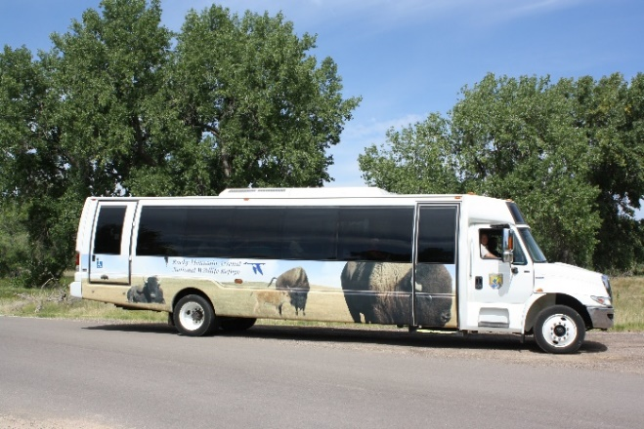
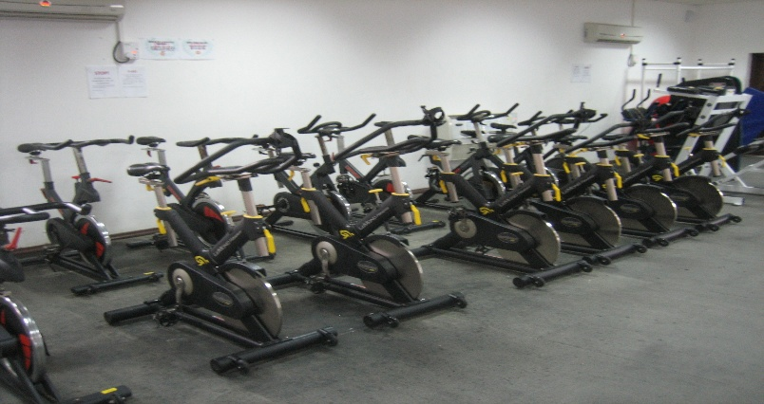
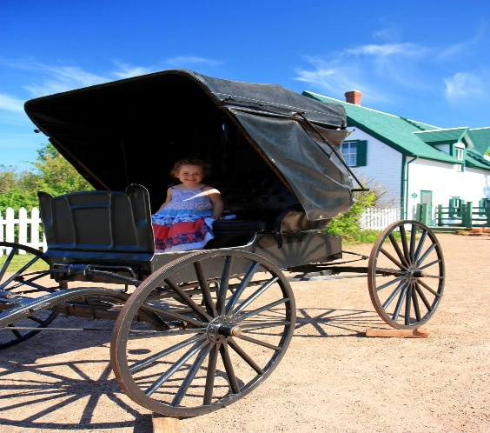
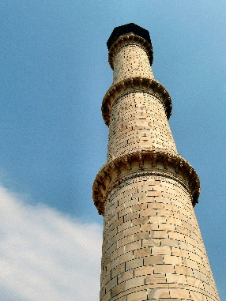
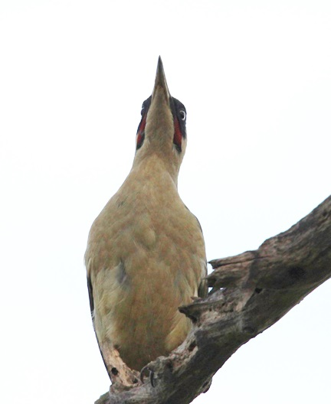
Fallback Strategy: Using Selected Images
Part A
Fallback Image Selection
Rationale & Implementation
Five diverse images were manually chosen to cover different scenes and objects, enabling effective detection and captioning despite GAN failure.
Using real images allowed us to bypass GAN limitations, ensuring accurate object detection with YOLOv8n and meaningful captions with BLIP-base models.
Notes:
Given the GAN challenges, we adopted the fallback strategy. Five diverse images, shown here – covering scenes like vehicles, animals, people, indoor objects, and architecture – were manually chosen. Using these real, clear images allowed us to bypass the GAN limitations and provide meaningful input for the subsequent object detection and captioning steps, ensuring we could test and demonstrate the remainder of the pipeline using effective pre-trained models like YOLOv8n and BLIP-base.

Slide 6
Object Detection Methodology (YOLOv8n)
Methodology
01
02
03
04
Model Choice: YOLOv8n
Detection Process
Post-processing Criteria
Rationale for Method
We selected YOLOv8n, the nano variant, due to its balance of speed and accuracy, pre-trained on the COCO dataset for 80 object classes.
Images are input to the YOLOv8n model loaded on a GPU. Predictions include bounding boxes, class labels, and confidence scores for detected objects.
Detections with confidence scores above approximately 0.25 are retained. Bounding boxes are drawn on images and detection data is extracted for analysis.
Using a pre-trained model avoids costly training. YOLOv8n’s lightweight architecture ensures fast inference, suitable for processing our five fallback images efficiently.
Notes:
For object detection on these five images, we selected the YOLOv8n model, the fast 'nano' variant, known for its good balance of speed and accuracy on common objects, as it's pre-trained on the COCO dataset. The detection process involved loading the model onto the GPU, inputting the images, and receiving predictions including bounding boxes, class labels, and confidence scores. In post-processing, typically detections with confidence scores above roughly 0.25 are retained, and bounding boxes are drawn on the output images. The rationale for this method was to leverage a powerful pre-trained model, avoiding costly training, while using an efficient architecture suitable for processing our images quickly.

Slide 7
Image Captioning Methodology (BLIP-base)
Methodology
01
Model Selection
BLIP-base was chosen for its strong pre-trained vision-language capabilities, enabling zero-shot captioning without task-specific fine-tuning.
02
Implementation
Using the Hugging Face transformers library, the BLIP processor and model were loaded on GPU. Images were preprocessed and passed through the model to generate captions.
03
Processing Pipeline
Images are input to the BLIP processor, then the model generates token sequences which are decoded into natural language captions, providing detailed descriptions of image content.
Notes:
Following detection, the final step in the Part A pipeline was image captioning. We chose the BLIP-base model, accessed via the Hugging Face Transformers library, for this task. BLIP-base is recognized for its strong pre-trained vision-language capabilities, allowing effective 'zero-shot' captioning without needing specific fine-tuning for our images. The implementation involved loading the BLIP processor and model onto the GPU. Images were then preprocessed by the processor and passed through the model, which generated token sequences representing the captions. These sequences were then decoded back into natural language text to describe the image content.

Slide 8
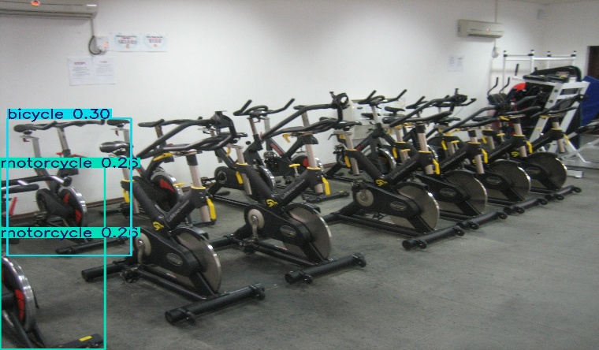
Detection & Captioning: Image 1 (Bikes)
Part A Results
Image Captioning Results
Object Detection Results
Caption generated: 'a row of stationary bikes in a gym’.
Caption accurately describes the scene, complementing detection results.
Detected: bicycle (30%), motorcycle (25%). Moderate confidence; some ambiguity between similar objects.
Notes:
Now let's look at the results for each image. For Image 1, the stationary bikes, YOLOv8n detected 'bicycle' with 30% confidence and 'motorcycle' with 25%. The low confidence and ambiguity reflect the model struggling slightly with this specific object type. However, the BLIP model generated an accurate caption: 'a row of stationary bikes in a gym', correctly identifying the objects and context.

Slide 9
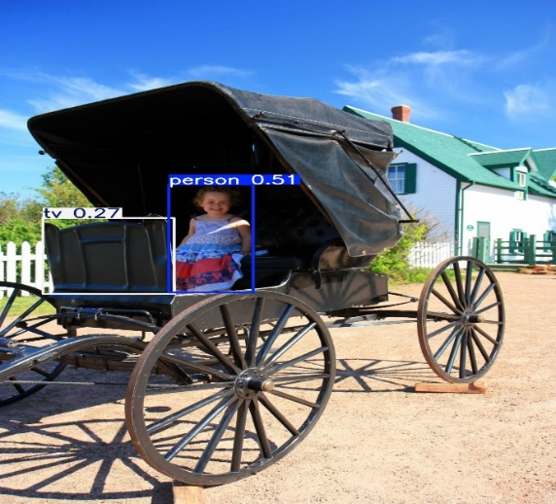
Detection & Captioning: Image 2 (Carriage)
Part A Results
Detected Objects
Detected: person (51%), tv (27%). The model correctly identifies the person but misclassifies part of the image as a TV, showing some detection limitations.
02
Image Captioning
Caption generated: 'a little girl sitting in a horse drawn carriage'. The caption accurately describes the scene despite detection errors, highlighting BLIP-base model's robustness.
Notes:
In Image 2, YOLOv8n successfully detected the 'person' with 51% confidence. However, it also misclassified part of the carriage as a 'tv' with 27% confidence, highlighting a limitation or occasional 'hallucination' in pre-trained models. Despite this detection quirk, the generated caption 'a little girl sitting in a horse drawn carriage' accurately described the overall scene, showcasing the robustness of the BLIP model.

Slide 10
Detection & Captioning: Image 3 (Tower)
Part A Results
Detection Results
No objects were detected above the confidence threshold, resulting in no bounding boxes on the tower image.
Captioning Results
The image captioning model generated the caption: 'a tall tower with a clock on top', accurately describing the scene despite detection failure.
Notes:
For Image 3, the tower, YOLOv8n did not detect any objects above the default confidence threshold, resulting in no bounding boxes being drawn. This is likely because 'tower' isn't a standard COCO class or wasn't prominent enough for the nano model. Nonetheless, the captioning model successfully identified the main subject, generating 'a tall tower with a clock on top'.

Slide 11
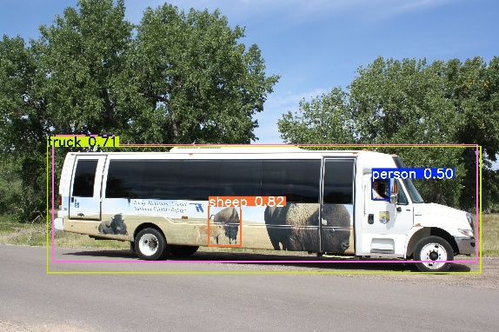
Detection & Captioning: Image 4 (Bus)
Part A Results
Captioning Result
Detection Results
Caption generated: 'a bus parked on the side of the road', accurately capturing the main scene despite some detection quirks.
Detected objects include truck (71%), person (50%), sheep (82%), and bus. The model showed an interesting detection of a sheep graphic on the bus.
Notes:
Image 4, the bus, yielded interesting detection results. YOLOv8n identified 'truck' with 71% confidence, 'person' (the driver) at 50%, and 'bus' (likely lower confidence, hence 'truck' might be the primary label shown). Notably, it also detected the 'sheep' graphic on the bus with high confidence (82%). The caption 'a bus parked on the side of the road' was accurate and concise.

Slide 12
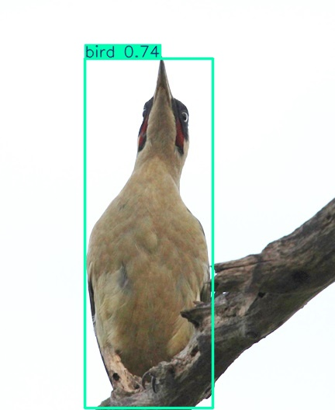
Detection & Captioning: Image 5 (Bird)
Part A Results
Detection Results
Detected: bird (74% confidence). The object detector correctly identified the bird with a strong confidence score, demonstrating effectiveness on natural scenes.
Captioning Results
Caption: 'a bird sitting on top of a tree branch'. The captioning model accurately described the scene, highlighting the bird's position and environment.
Notes:
Finally, for Image 5, the bird was correctly detected by YOLOv8n with a solid confidence of 74%. The corresponding caption, 'a bird sitting on top of a tree branch', accurately described the bird and its environment, demonstrating successful application of both models on this natural scene.

Slide 13
Part A Discussion & Limitations
Analysis
Primary objects | Objects detected | Detection Outcome
bicycle | bicyle, motorcycle | Correct (0.3)
person | Person, carriage | Correct(0.51)
Tower | Tower | misclassified
Bus | Bus, truck, sheep, person | Correct (0.5)
Bird | Bird | Correct (0.74)
Success with Fallback Pipeline
Using pre-selected images allowed continuation of the project after GAN failure, enabling successful object detection and captioning with YOLOv8n and BLIP-base models.
YOLOv8n Detection Performance
YOLOv8n effectively detected key objects with reasonable confidence but showed limitations such as some misclassifications (e.g., TV mislabeling) and occasional false positives.
BLIP Captioning Strengths
BLIP-base generated coherent and relevant captions even when detection failed, demonstrating robust vision-language understanding from pre-trained weights.
Overall Limitations
GAN training did not produce realistic images, restricting end-to-end pipeline testing. Detection and captioning models have bounded accuracy influenced by dataset domain and model size.
Notes:
To summarize Part A, using the fallback images allowed successful execution of the detection and captioning pipeline. The table provides a quick overview of the primary objects and detection outcomes. YOLOv8n effectively detected key objects in most images, showing reasonable confidence, but also exhibited limitations like misclassifications (the 'tv' example) and struggles with ambiguous objects (the bikes). BLIP-base consistently generated coherent and relevant captions. The overall limitations stem mainly from the failure of the GAN training to produce usable images initially, and the inherent accuracy bounds of using lightweight, general pre-trained models like YOLOv8n for detection.

Slide 14
Reinforcement Learning: Pong Environment
Reinforcement Learning Game Design Strategy
Game: Classic Pong, chosen for its simple yet dynamic nature and clear objective. Objective: Control a vertical paddle to intercept a moving ball, preventing it from passing your side while trying to score points by making it pass the opponent's paddle. Environment: 2D rectangular screen with two paddles moving vertically along the left and right edges, and a ball that moves horizontally and vertically with realistic bouncing off walls and paddles.
Notes:
Moving to Part B, the task was to design a Reinforcement Learning strategy conceptually. I chose the classic game Pong for this design. Pong was selected for its simple yet dynamic nature, clear objective, well-defined state and action spaces, and straightforward reward mechanism, making it ideal for illustrating the core RL principles without excessive complexity. The objective is to control a paddle to hit a ball past the opponent.

Slide 15
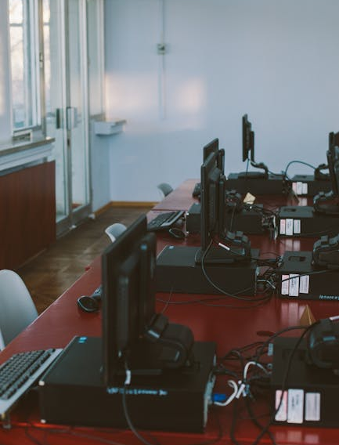



States, Actions, and Rewards in Pong
Reinforcement Learning
States (S)
The state was represented by a vector containing: Player Paddle Y Position, Ball X Position, Ball Y Position, Ball X Velocity, Ball Y Velocity, and optionally Opponent Paddle Y Position.
Actions (A)
The agent's discrete actions were: Move Up, Move Down, and Stay Still, controlling the paddle's vertical movement to intercept the ball.
Rewards (R)
Reward (+1.0) for scoring a point, penalty (-1.0) for opponent scoring, shaping reward (+0.1) optionally for hitting the ball, and neutral reward (0.0) for wall bounces.
Notes:
For the RL design, we first define the key components. The State (S) represents what the agent 'sees' – crucial information like the player's paddle position, the ball's X and Y position, and the ball's X and Y velocity. The Actions (A) are what the agent can 'do' – in Pong, this is simply moving the paddle Up, Down, or staying Still. The Rewards (R) provide the feedback signal – typically +1 for scoring a point, -1 for being scored upon, and optionally a small positive shaping reward for hitting the ball could be added.

Slide 16
RL Modeling Hypothesis & State Representation
Reinforcement Learning
01
02
State Representation and Action Selection
Reward and State Distribution
State represented by a feature vector of 5-6 normalized variables. Variables include player paddle Y position, ball X/Y positions, ball X/Y velocities, optional opponent paddle Y position. Actions are discrete: move up, move down, stay still. DQN estimates Q-values for each action based on state. Epsilon-greedy strategy balances exploration and exploitation during training.
State transitions follow deterministic physics of Pong game. Rewards are sparse, mainly at rally end (scoring events). Reward +1.0 for player scoring, penalty -1.0 for opponent scoring. Optional shaping reward +0.1 for hitting the ball. Neutral reward (0.0) for other events like wall bounces.
Notes:
Next, we define the modeling hypothesis. The state would be represented numerically as a feature vector containing those 5 or 6 normalized variables. Actions are discrete. Action selection would be handled by a Deep Q-Network, or DQN, which estimates the value (expected future reward) of each action given the state. An epsilon-greedy strategy would typically be used during training to balance exploring new actions versus exploiting known good actions. Regarding rewards, the main +1/-1 rewards occur sparsely at the end of a rally, while the game physics provide deterministic state transitions.

Slide 17
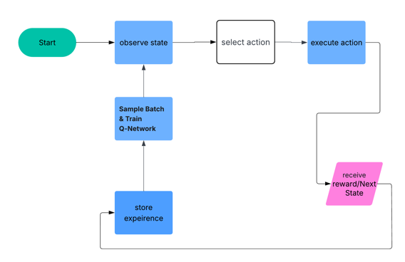
DQN Architecture for Pong Agent
Reinforcement Learning
DQN Neural Network Design
Model Type: Deep Q-Network (DQN) suitable for continuous state spaces and discrete actions common in classic games like Pong. Architecture: Multi-Layer Perceptron (MLP) with an input layer, two hidden dense layers, and an output layer. Input Layer: Approximately 6 units corresponding to normalized state features including paddle and ball positions and velocities. Hidden Layers: Two dense layers with 64 to 128 neurons each, using ReLU activation functions for non-linearity. Output Layer: Dense layer with 3 linear output neurons representing Q-values for the actions: Move Up, Move Down, and Stay Still.
Notes:
The proposed 'brain' for the agent is a Deep Q-Network using a simple Multi-Layer Perceptron architecture. It takes the state vector (~6 inputs) as input, passes it through two hidden dense layers with ReLU activation for non-linearity, and finally outputs 3 linear values representing the Q-values for moving Up, Down, or Staying Still. (Point to flowchart) The overall training process follows this loop: The agent observes the state, selects an action using its policy, executes it, receives a reward and the next state, stores this experience, and then samples batches of past experiences to train the Q-network, updating its estimates before repeating the cycle.

Slide 18
RL Training & Reward Strategy
Training
The Deep Q-Learning (DQN) training procedure uses experience replay, target networks, discounting of future rewards, and epsilon-greedy exploration with annealing to ensure stable and effective learning. These techniques collectively improve the agent's ability to maximize long-term rewards while balancing exploration and exploitation.
Experience Replay
Target Network Updates
Discounting Future Rewards
Epsilon-Greedy Exploration & Annealing
Initialize an experience replay buffer with a size of approximately 50,000 to 100,000 transitions. Store agent-environment interactions as transitions (state, action, reward, next state) in the buffer. Sample mini-batches of transitions randomly during training to break correlation between sequential data and improve stability.
Maintain two Q-networks: the main Q-network and a target Q-network with identical initial weights. Periodically update the target network weights to match the main network weights (e.g., every 1,000 to 10,000 training steps). This stabilizes training by providing fixed Q-value targets during temporal difference updates.
Apply a discount factor gamma (≈ 0.99) to future rewards, valuing long-term gains highly. Calculate target Q-values as the immediate reward plus the discounted maximum Q-value of the next state. Encourages the agent to focus on maximizing cumulative future rewards rather than immediate gains.
Use an epsilon-greedy policy to select actions, balancing exploration and exploitation. Start with epsilon = 1.0 for full exploration, gradually annealing epsilon down to approximately 0.05 to 0.1 over training. This strategy prevents premature convergence and helps the agent discover effective policies.
Activities
Experience replay buffer Random mini-batch samples for training Stored transitions for learning
Main Q-network and target Q-network Scheduled target network weight updates Stable Q-value target references
Discount factor gamma (≈ 0.99) Target Q-value calculations Future reward consideration in learning
Epsilon-greedy action selection Epsilon annealing schedule Balanced exploration-exploitation during training
Deliverables
Notes:
The training strategy would employ standard DQN techniques for stability and efficiency. Experience Replay stores transitions in a buffer (e.g., 50-100k entries) and samples mini-batches randomly to break correlations. Target Network Updates involve using a separate, slowly updated network to calculate stable target Q-values for the loss function. Discounting Future Rewards, using a gamma close to 1 like 0.99, ensures the agent plans for long-term success (scoring points). And Epsilon-Greedy Exploration & Annealing ensures the agent explores sufficiently early on by starting with random actions (epsilon=1.0) and gradually becomes more deterministic (exploiting learned knowledge) as epsilon decays to a small value like 0.05.

Slide 19




RL Agent Evaluation & Analysis Framework
Evaluation
Average Score per Episode
Win Rate
Tracks the mean score achieved by the RL agent in each episode, reflecting its ability to win points against the opponent over time.
Measures the percentage of episodes the agent wins, indicating effectiveness in achieving the game objective consistently.
Average Rally Length
Learning Curve Visualization
Calculates the average duration of exchanges (rallies) in gameplay, providing insight into the agent’s defensive and offensive capabilities.
Plots the agent’s performance metrics such as score against episodes to visualize training progress and stability over time.
Notes:
To evaluate if the training is successful, we would track several metrics. Key indicators include the Average Score per Episode (or win rate), showing if the agent is learning to achieve the game objective. Average Rally Length could provide insight into its defensive capability. And plotting these metrics over training episodes helps visualize the learning progress and stability.

Slide 20

Project Conclusions & Insights
Conclusion
This project successfully addressed the core requirements for both image-based deep learning and reinforcement learning design. Part A demonstrated the construction of an image processing pipeline, including a documented attempt at GAN-based image generation (Appendix A) which justified adopting a fallback strategy. The subsequent pipeline using pre-trained YOLOv8n and BLIP models effectively performed object detection and image captioning (Section 2.4), providing plausible results while highlighting model limitations. Part B presented a comprehensive theoretical design for an RL agent to play Pong, detailing the necessary states, actions, rewards, DQN architecture, and conceptual training framework. The project highlighted both the power of leveraging pre-trained models and the design principles of RL. Future work could involve implementing the Pong RL agent or exploring more advanced models and fine-tuning techniques for the Part A pipeline.
Notes:
In conclusion, this project successfully navigated both Part A and Part B. Part A demonstrated the implementation of an image processing pipeline, justifying the use of a fallback strategy after documenting challenges with GAN training, and achieving effective object detection and captioning using YOLOv8n and BLIP. Part B presented a comprehensive theoretical design for an RL agent to play Pong, detailing the states, actions, rewards, and a suitable DQN framework. Key insights include the practical utility of pre-trained deep learning models and the fundamental principles involved in designing RL solutions. Future work could focus on implementing the Pong agent or exploring enhancements to the image pipeline.

Slide 21

Conclusion
Thank you for your attention. I welcome your questions and feedback.
This concludes the presentation. Please feel free to ask any questions or share your insights on the image-based deep learning pipeline and reinforcement learning strategy design discussed today.

